Slide 1





Task Productivity Booster with Distraction Control
Introduction to Robotic Process Automation
Register No Name
: 2116220701014
: AFRIN FATHIMA I
Guide Name : Mrs. J. JINU SOPHIA
Designation : Assistant Professor (SG) Department : Computer Science & Engineering

Slide 2
Abstract
The Task Productivity Booster with Distraction Control is an innovative automation solution developed using UiPath to help users maximize productivity and manage distractions effectively. Designed for modern digital environments, the bot empowers users to maintain focus by blocking non-essential websites and applications during designated work intervals. It incorporates features such as task tracking, time management, and customizable work-break schedules to optimize efficiency and ensure goal-oriented workflows. By fostering a distraction-free environment, the bot not only enhances task completion rates but also supports better work-life balance, reducing stress and promoting well-being. This tool is adaptable and can evolve with future enhancements, such as wellness integration and mobile compatibility, to provide a holistic productivity-boosting experience.
Rajalakshmi Engineering College
2

Slide 3
Need for the Proposed System
In today’s technology-driven world, distractions like social media and entertainment platforms significantly hinder productivity. Students and professionals often struggle to focus, leading to inefficiency, stress, and poor time management. Traditional methods fail to address the challenges of balancing work and distractions effectively. The Task Productivity Booster with Distraction Control meets this critical need by automating focus enhancement, task management, and distraction blocking. It provides a structured environment that promotes concentration and efficiency while tracking productivity.
This innovative solution empowers users to manage their tasks
better, maintain focus, and achieve work-life balance, making it essential for academic and professional success.
Rajalakshmi Engineering College
2

Slide 4
Advantages of the Proposed System
Enhanced Focus and Productivity: By blocking distracting websites and applications during work sessions, the system creates a dedicated, distraction-free environment for improved concentration.
Customizable Task Management: Users can input tasks and manage work sessions with tailored intervals, optimizing efficiency and personalizing the work process.
Improved Time Management: With features like automated time tracking and structured workflows, users can allocate time effectively, minimizing wastage.
Stress Reduction: Eliminating distractions and promoting structured task management reduces stress and enhances a sense of accomplishment.
Work-Life Balance: Encourages efficient task completion, leaving more
time for personal activities and relaxation.
Rajalakshmi Engineering College
2

Slide 5
Literature Survey
Paper : V. Srinivasan and A. Elango, “Automating work-life balance with time management bots”, 2017
Advantages: Disadvantages:
1. Reduces Digital Distractions: 1. Communication
Overload: prompts
Automatically blocks distracting
Frequent chatbot clutter
websites during work-break transitions, improving focus.
2. Enhances Well-being: Helps
users' communication
channels, making them feel annoyed.
2. Privacy Concerns: Monitoring inactivity and website usage could raise concerns about how user data is collected and used.
manage stress by promoting a balance between necessary breaks and work.

Slide 6
Main Objective
The main objective of the Productivity Booster Bot is to enhance user productivity by creating a structured, distraction-free work environment. This is achieved by blocking non-essential websites and applications during designated work intervals, promoting focus, and helping users manage their time effectively. The bot aims to reduce digital distractions, improve task completion efficiency, and foster better time management, ultimately contributing to improved work outcomes, reduced stress, and a healthier work-life balance.

Slide 7
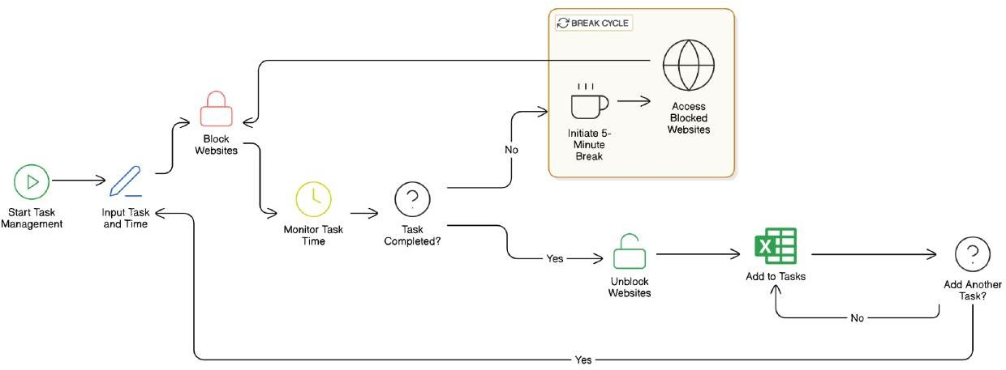
Architecture
End Process
No

Slide 8
System Requirements
Hardware:
Processor: Dual-Core or higher (Intel i3/AMD equivalent).
RAM: 4 GB (8 GB recommended).
Storage: 100 GB free space (SSD preferred).
Network: Stable internet connection (5 Mbps or higher).
Software:
OS: Windows 10/11, macOS, or Linux.
Tools: UiPath Studio, UiPath Robot, UiPath Orchestrator.
Data Source: Excel for schedules and reminders.

Slide 9
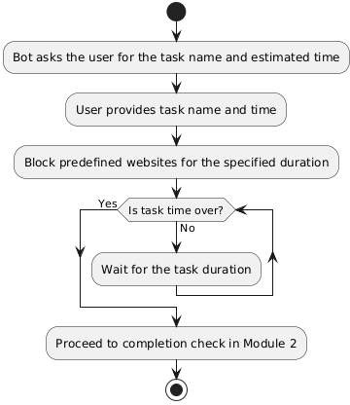
Functional Description
Module 1: Task Initialization and Website Blocking
This module focuses on collecting the task name and estimated time from the user. Once the input is provided, the bot blocks a predefined list of distracting websites for the specified duration, ensuring a focused work environment.
Activity Diagram-Module 1 :

Slide 10
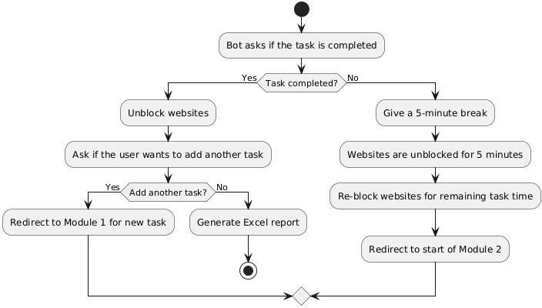
Functional Description
Module 2: Task Completion and Workflow Management
This module verifies task completion. If completed, websites are unblocked, and the user can add a new task. If not, the bot gives a 5-minute break before repeating the process until the task is done.
Activity Diagram-Module 2:

Slide 11
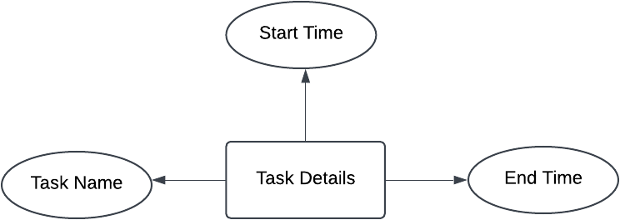
Table Design
Task Name: Stores the name or description of the task being performed.
Start Time: The timestamp indicating when the task started.
End Time: The timestamp indicating when the task was completed.

Slide 12
Process Design
Bot asks the user for the task name and estimated time to complete the task.
Bot blocks a predefined list of websites for the specified duration.
After the time is up, the bot asks if the task is completed.
If "Yes", the bot unblocks the websites.
If "No", the bot gives a 5-minute break with websites unblocked.
After the break, the bot blocks the websites again for the remaining task time.
This process repeats until the user completes the task.
After completing the task, the bot asks if the user wants to add another task.
If "Yes", the process repeats for the new task.
The workflow continues until the user completes all tasks or decides to stop.

Slide 13
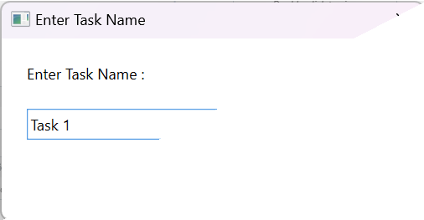
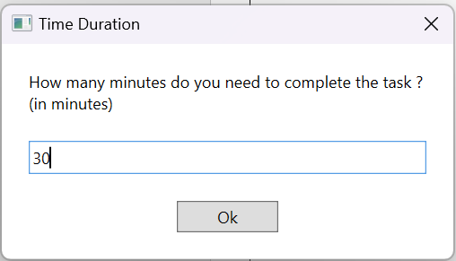
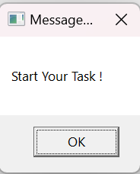
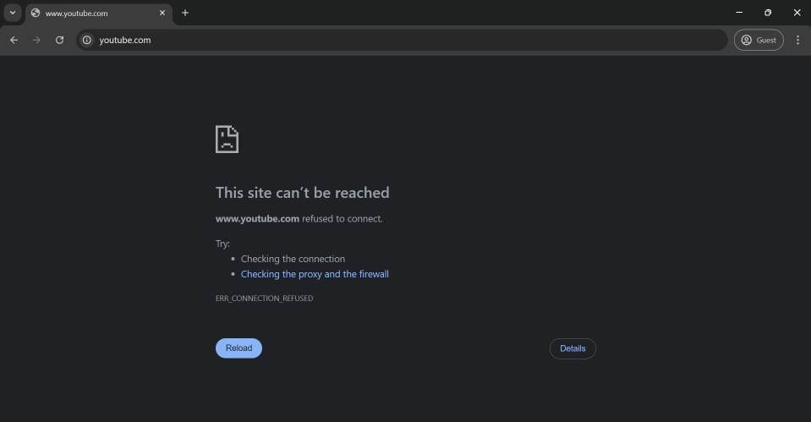
Implementation

Slide 14
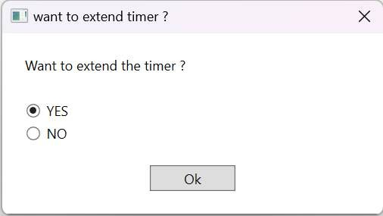
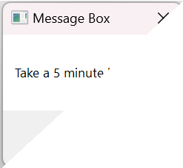
Implementation

Slide 15
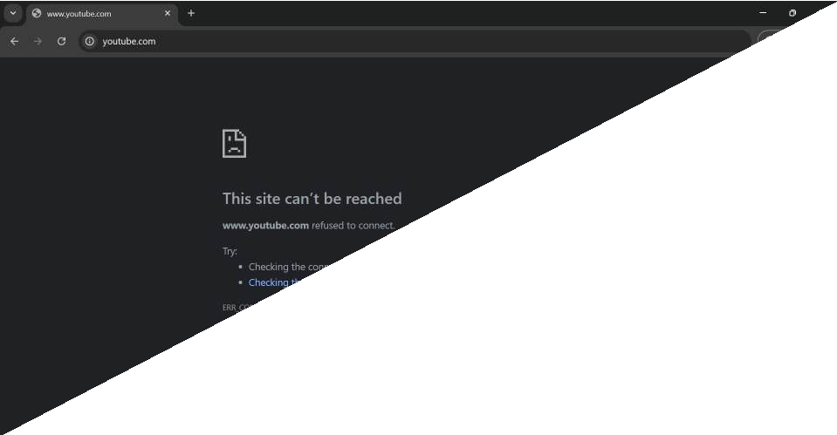
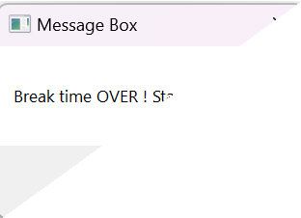
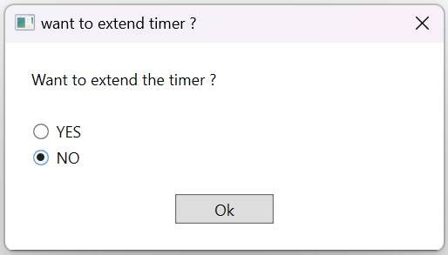
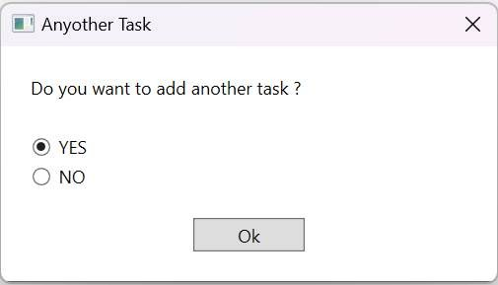
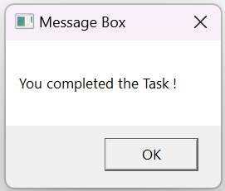
Implementation

Slide 16
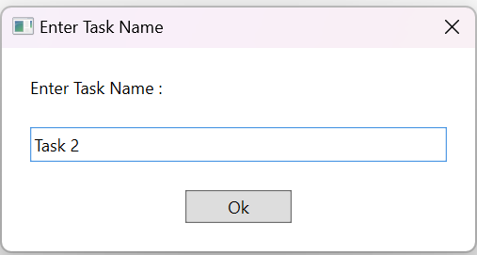
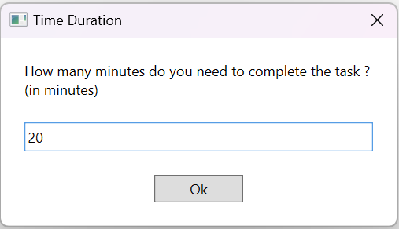
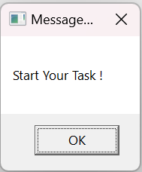

Implementation

Slide 17
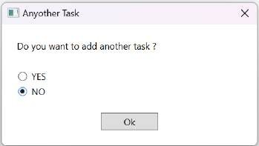
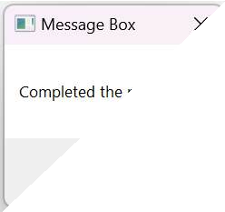
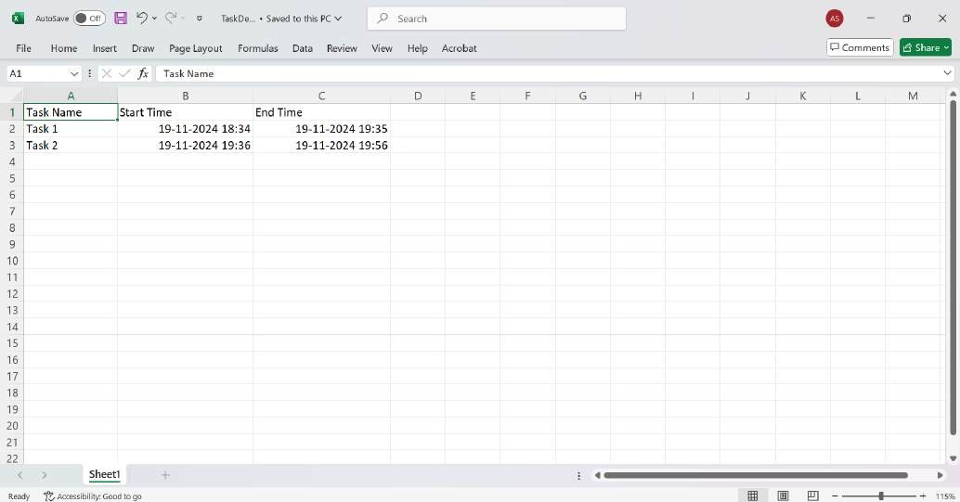
Implementation

Slide 18
Testing
Test Description: Verify if task details and completion status are correctly recorded in the Excel report.
Input: Task name "Study", time "30 minutes". User marks task as "Completed".
Expected Output: Excel file should contain "Task Name", "Start Time", "End Time“ for the task "Study", along with the correct timestamps.
Actual Output: Excel sheet is generated with the correct details including task name, start and end times.

Slide 19
Conclusions
The Productivity Booster Bot effectively addresses the challenges of digital distractions and poor time management, offering a structured and efficient solution for enhancing productivity. By blocking distracting websites during focused work sessions and incorporating customizable break intervals, the bot helps users maintain concentration and achieve their goals. The system also enables continuous task tracking, ensuring users stay on track throughout the day. Overall, the bot provides a practical tool for improving productivity and fostering a healthier work-life balance. Future enhancements, such as mobile integration and wellness features, will further improve its functionality and impact.

Slide 20
Future Enhancement
Mobile App Integration:
Extend the bot’s functionality to mobile platforms, enabling synchronization of productivity data and distraction control across devices.
Wellness Integration:
Incorporate health reminders like stretching exercises, eye-care tips, and hydration alerts based on user activity throughout the day.
Automated End-of-Day Summary with Screen Time Monitoring: Generate an end-of-day report summarizing productivity, screen time, and app usage, with insights on improving efficiency and reducing distractions.

Slide 21
References
UiPath Documentation
How to block websites on Chrome, Safari, and more
V. Srinivasan and A. Elango, "Automating work-life balance with time management bots," in Proc.2017 Int. Conf. on Human-Computer Interaction, 2017, pp. 13-25, doi: 10.1145/3290605.3300697.

Slide 22

Thank You

